Slide 1
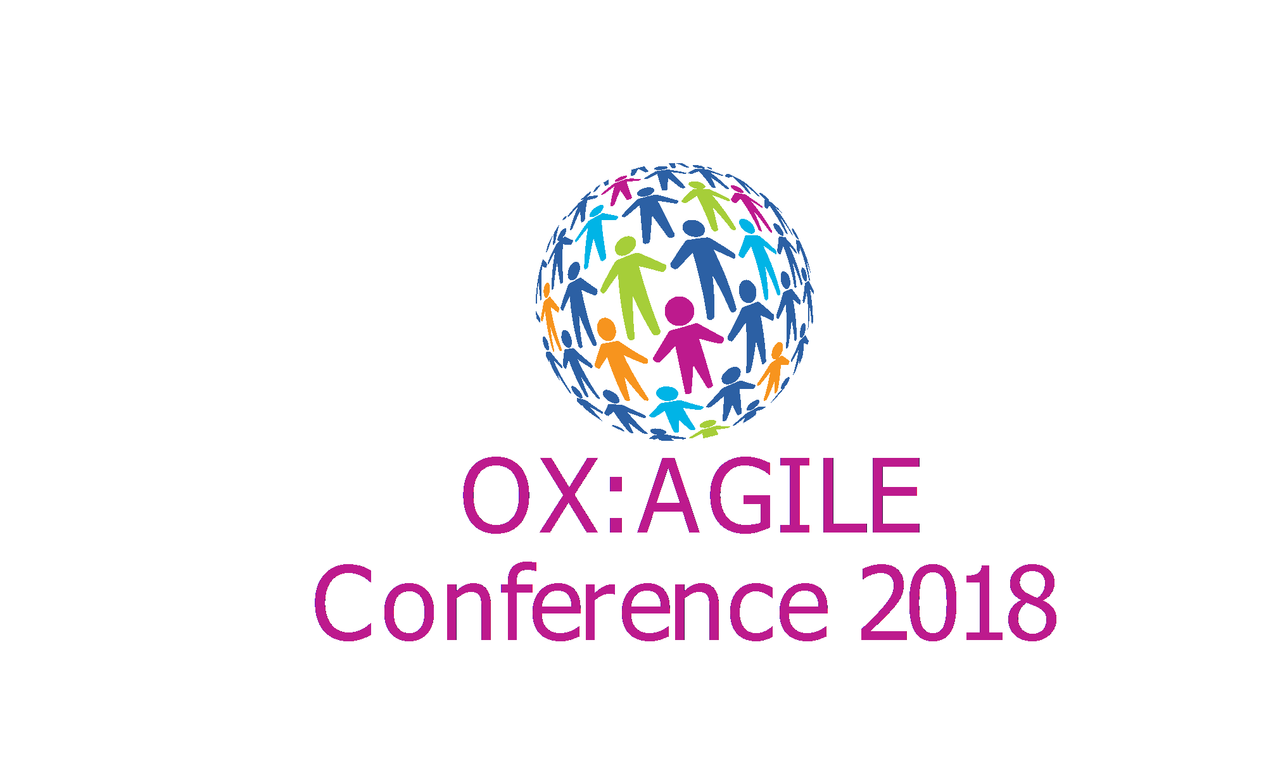

Slide 2
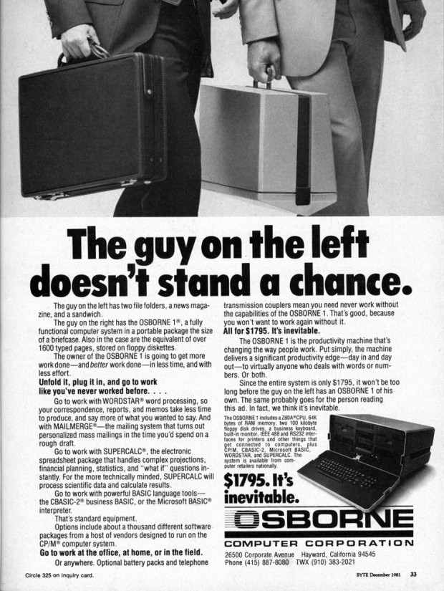
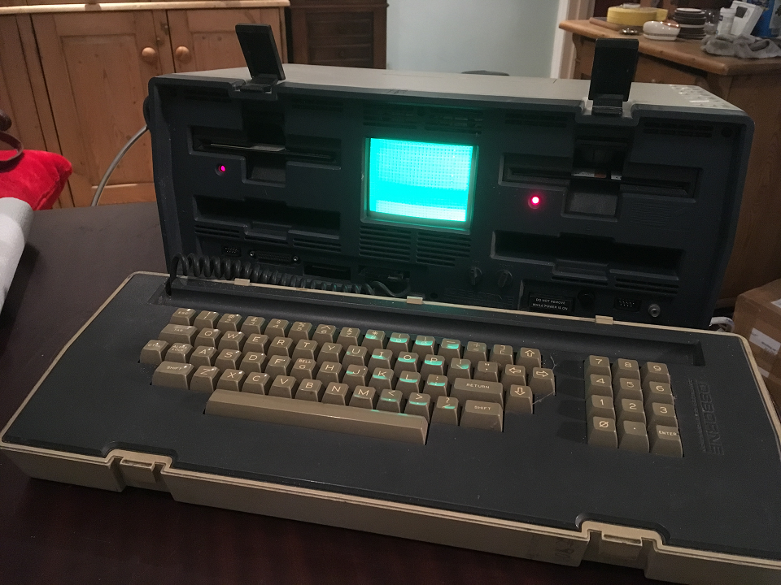

Slide 3
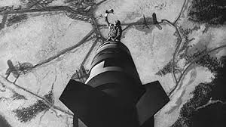
How I learned to stop worrying and love LEGACY CODE - Mike Harris -
Notes:
ALGOL-68

Slide 4
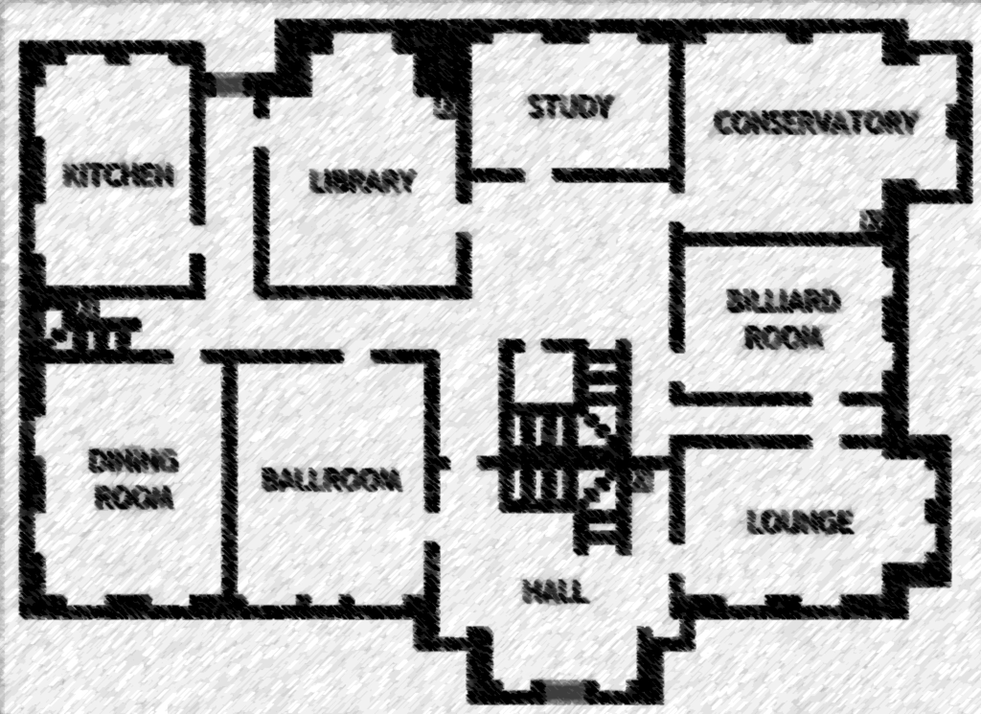
The Plan
Introduce myself
Legacy code
Definition
Causes
Effects
What we could do about it
What we should do about it
Sum up
Discuss and answer questions

Slide 5

About me
Got into home computers in the 1980s.
Wrote a Fractal generator in GFA BASIC on Atari ST.
Messed up my A levels.
Managed to get on a computing degree ;)
Got into Linux in early 90s.
Set up a company to promote Free Software.
We wrote our own CMS in Cold Fusion, then in Perl.
Since worked as a software engineer, and IT in general.
Found out about XP and Agile. Realised I was more of a hacker than a software engineer.
Joined Elsevier and SSRN in April this year.
Now working with ColdFusion again!

Slide 6
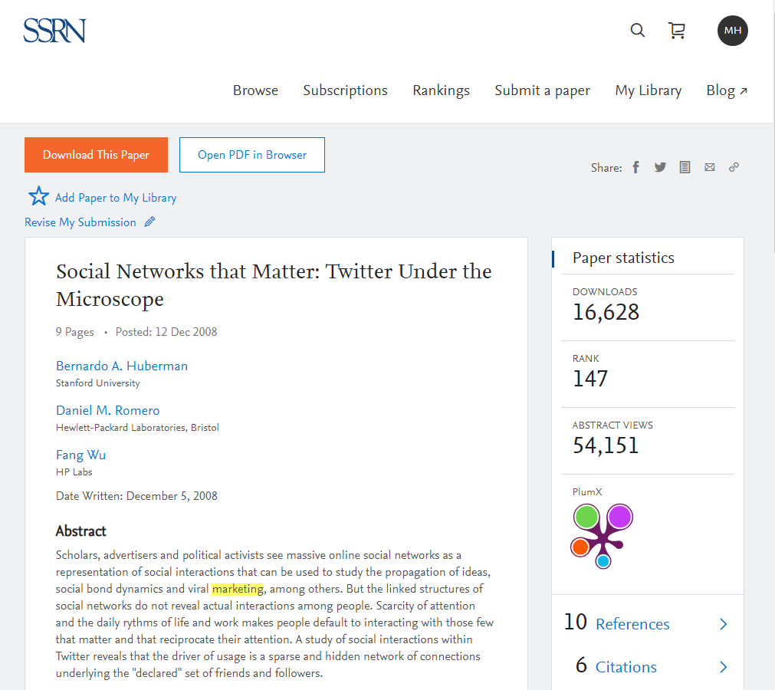



About SSRN
SSRN is an open access research repository and a community for researchers
We are a freely accessible repository of abstracts and pre-print full-text papers…
…and a community where researchers can shape the thinking in their fields

Slide 7
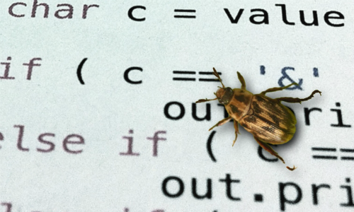
Things I’ve been heard saying…
“The code is really awful!”
“It takes so long to make changes!”
“We’re always introducing bugs!”
“We’ve no idea what this bit does!”
“Bob is away!”
“We hate it!”
“We need to rewrite the whole damn thing!”

Slide 8
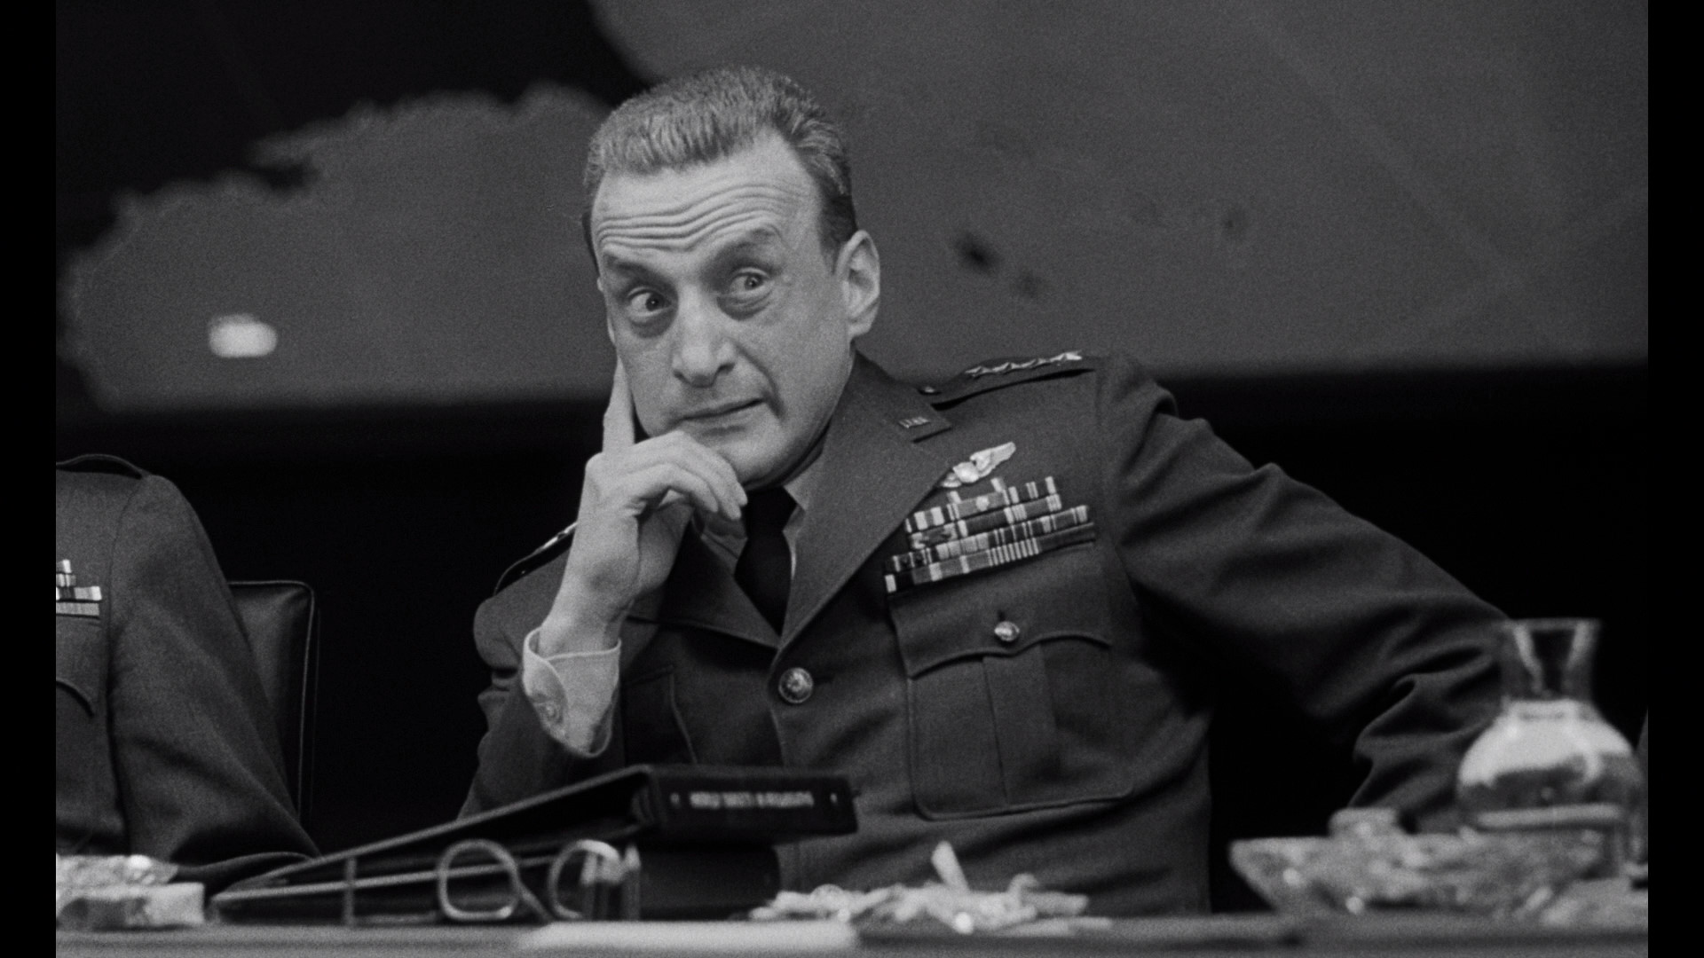
What is legacy code?

Slide 9

What is legacy code?
Legacy – adjective “of, relating to, or being a previous or outdated computer system.” – Merriam-Webster
A more recent definition in Software Engineering is… “Source code inherited from someone else and/or source code inherited from an older version of the software”
Michael Feathers in Working Effectively with Legacy Code names it as “Code without tests”

Slide 10
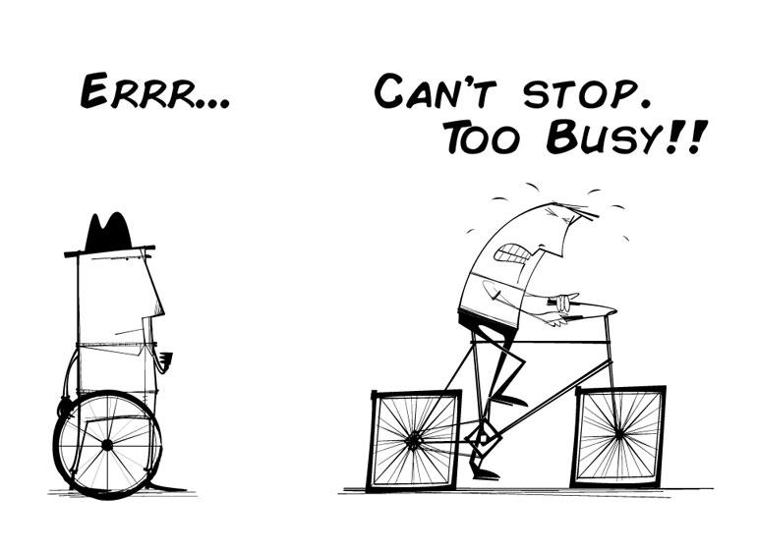
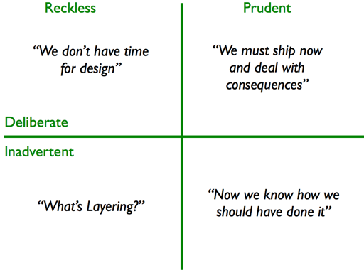
Legacy code as technical debt
A lot of legacy code is to be found here
Technical debt quadrant - Martin Fowler
"As an evolving program is continually changed, its complexity, reflecting deteriorating structure, increases unless work is done to maintain or reduce it.”
— Meir Manny Lehman, 1980
“Bad code isn't Technical Debt, it's an unhedged Call Option”
- Steve Freeman , 2010
Notes:
Call option – is that a buyer and seller have a contract by which the buyer has the right to buy a certain quantity of a certain commodity at a certain price at a certain time. Unhedged – means that no instruments have been put in place as a contingency against possible loss when the call option is exercised.

Slide 11
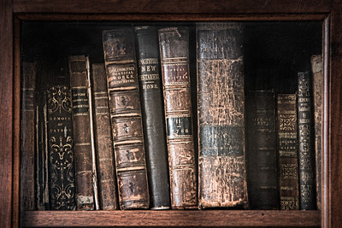
What is legacy code to an organisation?
A lot of investment.
Models business processes.
History of the enterprise.
Where we are today.
It “works”.
But it can be a pain to maintain and extend.

Slide 12

What hints at legacy code?
Unnecessary or misleading comments.
Poor or obtuse naming of things.
Large number of calling parameters.
Multiple code paths in single functions.
Functions with side-effects.
Long and unstructured code.
Poorly scoped variables.
A lack of tests.

Slide 13
What is legacy about this Perl code?
sub check_login { my ($query, $pathinfo, $dbh) = @_; my $login_email = $query->param($AUTH_USER_FIELD); my $login_pass = $query->param($AUTH_PASSWORD_FIELD); my ($statement, $sth, $id, $login, $admin_level, $cookie); $statement = qq{SELECT id FROM $AUTH_DB_TABLE WHERE $AUTH_USER_FIELD = '$login_email' AND $AUTH_PASSWORD_FIELD = '$login_pass'}; $sth = $dbh->prepare($statement); $sth->execute or die("Unable to execute $statement", $dbh->errstr); $sth->finish; # get the count of rows in the database # $x is the row count going forwards if ($sth->rows eq 0) { ChangingPages->fetch_page(APP_OPTIONS => \%APP_OPTIONS, QUERY => $query, FILE_NAME => $pathinfo . $query->param('_error_page'), ); return; } $statement = qq{ SELECT id, $AUTH_USER_FIELD, admin_level FROM $AUTH_DB_TABLE WHERE $AUTH_USER_FIELD = '$login_email' AND $AUTH_PASSWORD_FIELD = '$login_pass' AND (TO_DAYS(NOW()) - TO_DAYS(last_mod_pwd)) < $MAX_PASSWORD_EXPIRY }; $sth = $dbh->prepare($statement); $sth->execute or die("Unable to execute $statement", $dbh->errstr); if ($sth->rows eq 0) { $sth->finish; &display_change_passwd; return; } $sth->bind_columns(undef, \$id, \$login, \$admin_level); $sth->fetch; $sth->finish;
Poor naming
SQL Injection?
Inelegant error handling
Misleading Comment
Passing global arrays around
Open to hacking source HTML?
Closely coupled
Side-effect
Pretty much all of it!
There are no tests either!

Slide 14
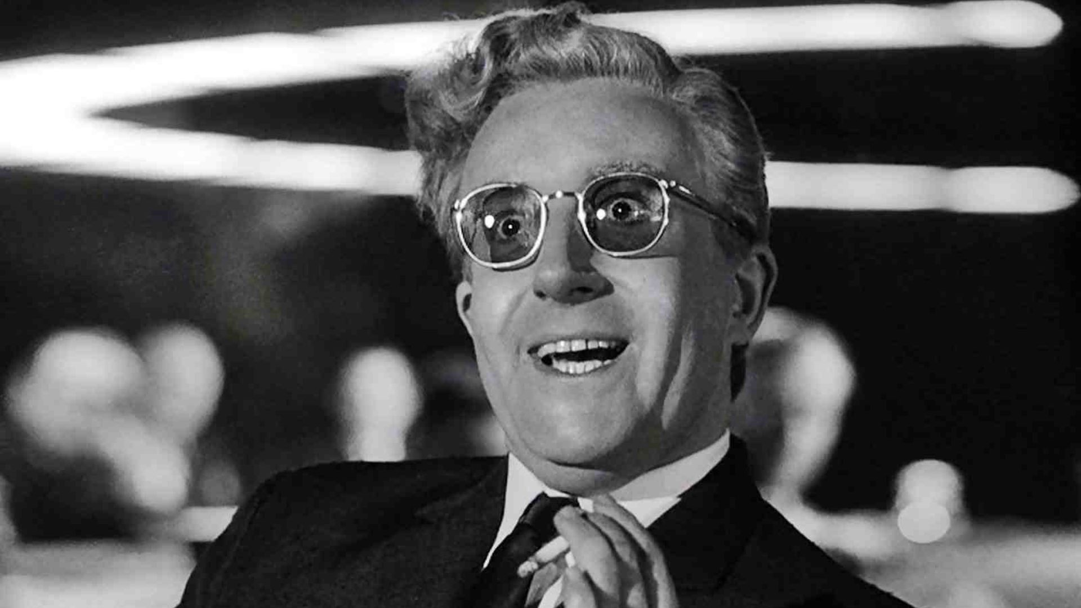
The causes of Legacy Code

Slide 15

The causes of legacy code
Old programming languages & the way we used them.
Old methodologies.
New methodologies not well understood.
Tasks done under pressure.
Hacks in code to solve bugs.
Not knowing any better – “we’ve always done it that way, and it works for us”.
Knowledge silos: solo programmers on one code area.
Rigid designs.

Slide 16
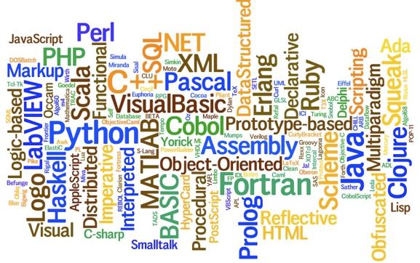
Legacy code is language agnostic
Legacy code isn’t necessarily code written in BASIC, COBOL, ColdFusion, Fortran, Algol, or even Perl.
It can be written in even the most up to date coolest programming language.
Replacing your COBOL or ColdFusion code with Java, Go, Groovy, Kotlin, ReactJS, or Scala doesn’t stop legacy code being written.

Slide 17
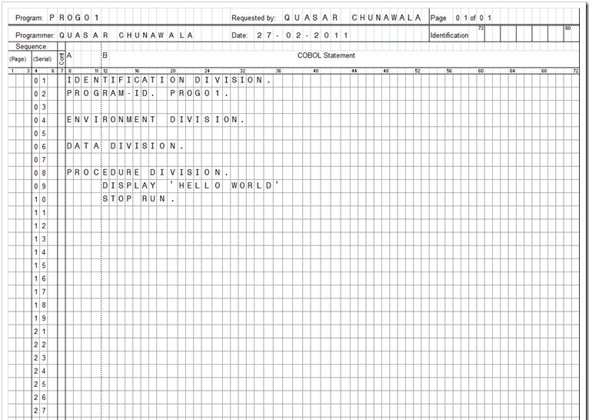
COBOL example
Descriptive naming
Identification division.
program-id. Stack.
*> Implements a stack in COBOL
*> Operators are: Pop, Push, and Peek
data division.
working-storage section.
01 StackTable is global.
02 StackItem pic x(20) occurs 1 to 50 times.
01 ItemsInStack pic 99 value zero is global.
linkage section.
01 Command pic x any length.
01 Item pic x any length.
procedure division using Command, Item.
Main section.
evaluate function trim(Command)
when "Push" perform PushItemOntoStack
when "Pop" perform PopItemOffStack
when "Peek" perform PeekWhichItemIsOnTopOfStack
end-evaluate
goback
.
PushItemOntoStack section.
add 1 to ItemsInStack
move Item to StackItem(ItemsInStack)
.
PeekWhichItemIsOnTopOfStack section.
move StackItem(ItemsInStack) to Item
.
PopItemOffStack section.
if ItemsInStack less than 1 then
move spaces to Item
else
move StackItem(ItemsInStack) to Item
move spaces to StackItem(ItemsInStack)
subtract 1 from ItemsInStack
end-if
.
end program Stack.
identification division.
program-id. StackTest.
*> A simple stack in COBOL
data division.
working-storage section.
01 Item pic x(10) value spaces.
01 Result pic x(10) value spaces.
procedure division.
TestShouldPopPushedItemsInReverseOrder.
*> Given
move "hello" to Item
call "Stack" using by content "Push", by content Item
move "hola" to Item
call "Stack" using by content "Push", by content Item
move "bonjour" to Item
call "Stack" using by content "Push", by content Item
*> When
call "Stack" using by content "Pop", by reference Result
*> Then
call "AssertEquals" using Result, "bonjour", "Returned 3rd value put on stack”
*> When
call "Stack" using by content "Pop", by reference Result
*>Then
call "AssertEquals" using Result, "hola", "Returned 2nd value put on stack”
Test Driven
Structured

Slide 18
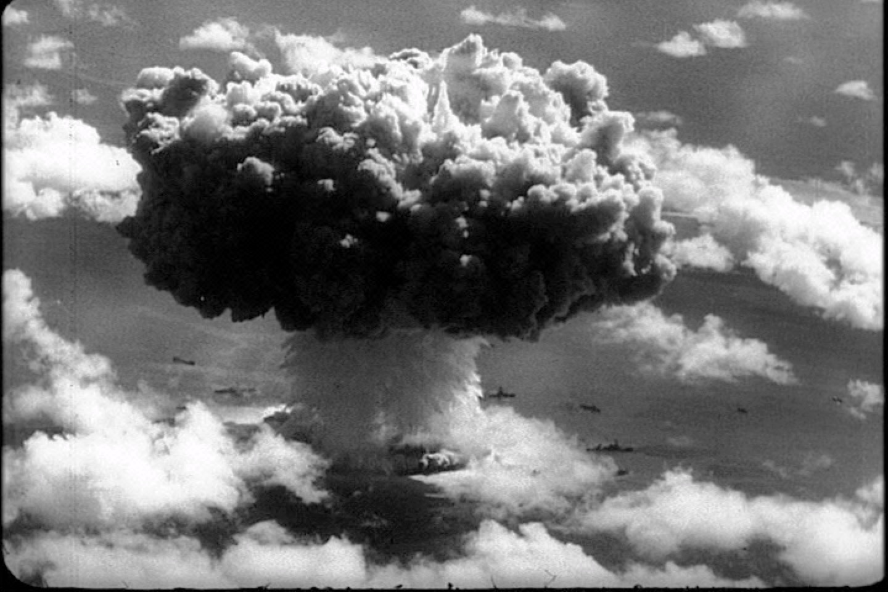
The effects of legacy code

Slide 19
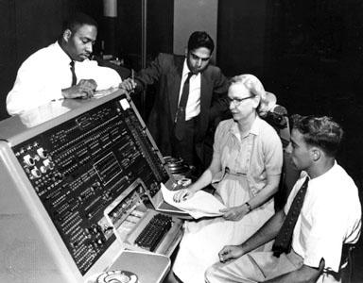
How it affects the developers
Changes take a long time.
Changes are risky.
Bugs are introduced.
Hacking makes things worse.
Working with it is frustrating.
Time pressures lead to stress.
.. and more hacks
The team has no real control over their software.
If it’s hard or impossible to change, then it’s not really software..
It is demoralising.

Slide 20
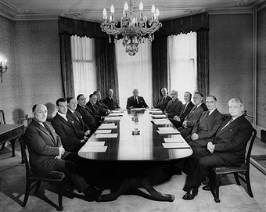
How it affects the business
New work can take longer than expected.
New work is difficult to estimate.
Changes can introduce bugs. Customer experience and trust is reduced, more wasted time, more cost.
Specialisations in the code cause delays.
Specialisations in the code are risks.

Slide 21
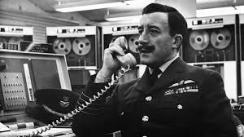
What can we do about legacy code?

Slide 22
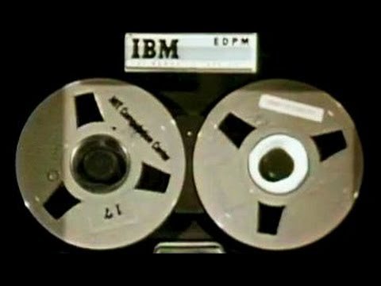
What can we do about legacy code?
Stop writing it!
Yeah right; what can we really do about it?
Fire everyone and get a new team!
Leave the job and go and work somewhere where they aren’t writing legacy code!
Throw everything we’ve done away and start again using something cool to do it in!
Let’s look at this last option….

Slide 23
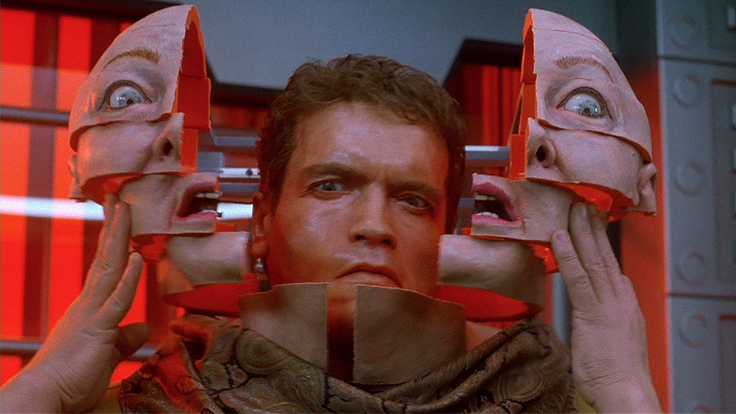
TOTAL REWRITE

Slide 24

The Total Rewrite plan….
“We’ll put a team together to re-write all the code in a modern up-to-date framework, language, paradigm, cloud-based-thingy.”
“We’ll maintain the old system until the new system is done.”
“The spec is that the new system must do at least everything the old system does.”

Slide 25
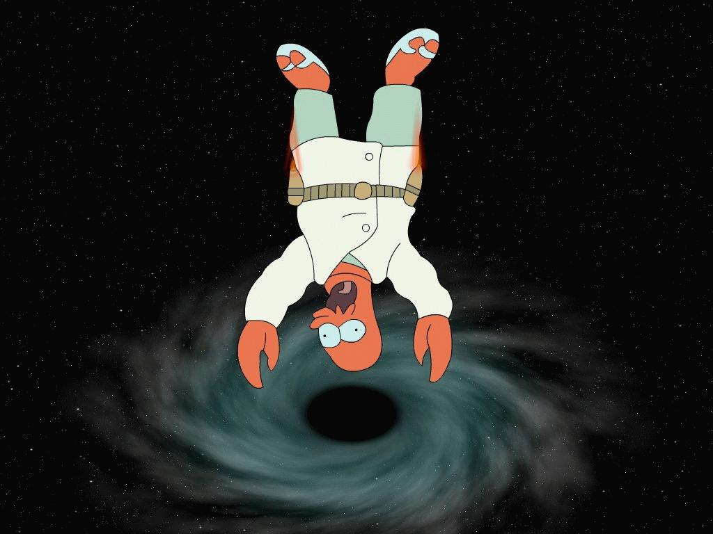
Pitfalls of the Total Rewrite
It costs money to seemingly stand still.
Changes to both systems; Zeno’s Paradox.
Do you re-implement the bugs?
The old legacy code doesn’t improve.
Delivery pressures leading to new legacy code.
Will you run two teams?
What if we never make it?

Slide 26
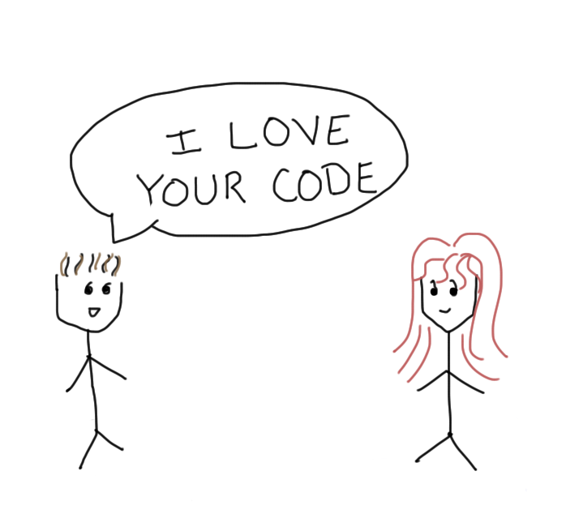
Change attitude
Stop hating the code.
Stop blaming others (or yourself) for writing it.
Accept that it’s where we are.
Don’t run away from it.
Stop ignoring it.
Believe that it can be improved.
Person up and deal with it.
Make it better.

Slide 27
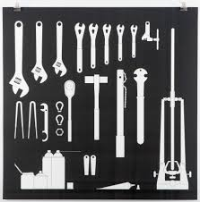
Improve our toolset & practices
Use TDD. Improve & replace bad tests.
Refactor code to make life easier for you; learn refactoring techniques and patterns.
Code standards, styles, patterns, approaches.
IDE and other tools.
Find seams to replace or improve parts of it.
Employ pair or mob programming.

Slide 28

Use seams, slices & stranglers
Introduce seams in the code.
Extend the legacy code, wrapping it to extend functionality.
Create slices of functionality in new code.
Strangler Pattern (Martin Fowler) – build a framework around existing system and gradually exterminate it.

Slide 29
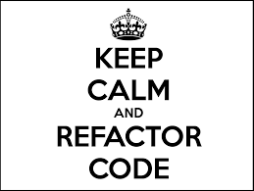
Refactor it
Refactor continuously. No story needed.
Once your code passes the test, spend a little longer to improve it.
Get rid of useless or misleading comments.
Rename variables and functions to be self-documenting.
Break up lengthy code.
Work towards one function doing one thing.
Encapsulate common code and data into classes.
Abstract resources from main code; de-couple.
If you cannot write any tests, try harder!

Slide 30
So what could we do with this?
sub check_login { my ($query, $pathinfo, $dbh) = @_; my $login_email = $query->param($AUTH_USER_FIELD); my $login_pass = $query->param($AUTH_PASSWORD_FIELD); my ($statement, $sth, $id, $login, $admin_level, $cookie); $statement = qq{SELECT id FROM $AUTH_DB_TABLE WHERE $AUTH_USER_FIELD = '$login_email' AND $AUTH_PASSWORD_FIELD = '$login_pass'}; $sth = $dbh->prepare($statement); $sth->execute or die("Unable to execute $statement", $dbh->errstr); $sth->finish; # get the count of rows in the database # $x is the row count going forwards if ($sth->rows eq 0) { ChangingPages->fetch_page(APP_OPTIONS => \%APP_OPTIONS, QUERY => $query, FILE_NAME => $pathinfo . $query->param('_error_page'), ); return; } $statement = qq{ SELECT id, $AUTH_USER_FIELD, admin_level FROM $AUTH_DB_TABLE WHERE $AUTH_USER_FIELD = '$login_email' AND $AUTH_PASSWORD_FIELD = '$login_pass' AND (TO_DAYS(NOW()) - TO_DAYS(last_mod_pwd)) < $MAX_PASSWORD_EXPIRY }; $sth = $dbh->prepare($statement); $sth->execute or die("Unable to execute $statement", $dbh->errstr); if ($sth->rows eq 0) { $sth->finish; &display_change_passwd; return; } $sth->bind_columns(undef, \$id, \$login, \$admin_level); $sth->fetch; $sth->finish;

Slide 31
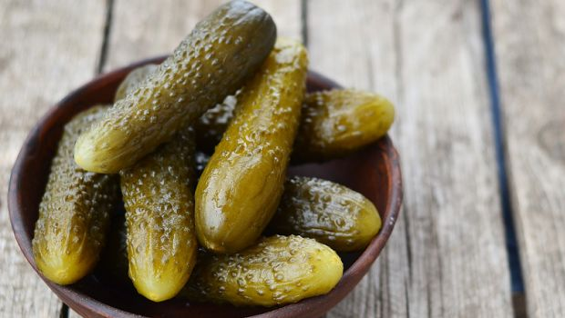
We could write some high-level tests in Gherkin
Given I visit the login page
And I enter an invalid username
And I enter a valid password
When I click the login button
Then I am taken to the login failed page
Given I visit the login page
And I enter a valid username
And I enter an invalid password
When I click the login button
Then I am taken to the login failed page
Given I visit the login page
And I enter a valid username
And I enter a valid password
When I click the login button
Then I am taken to the home page
Given My user login password has expired
And I visit the login page
And I enter a valid username
And I enter a valid password
When I click the login button
Then I am taken to the change password page

Slide 32
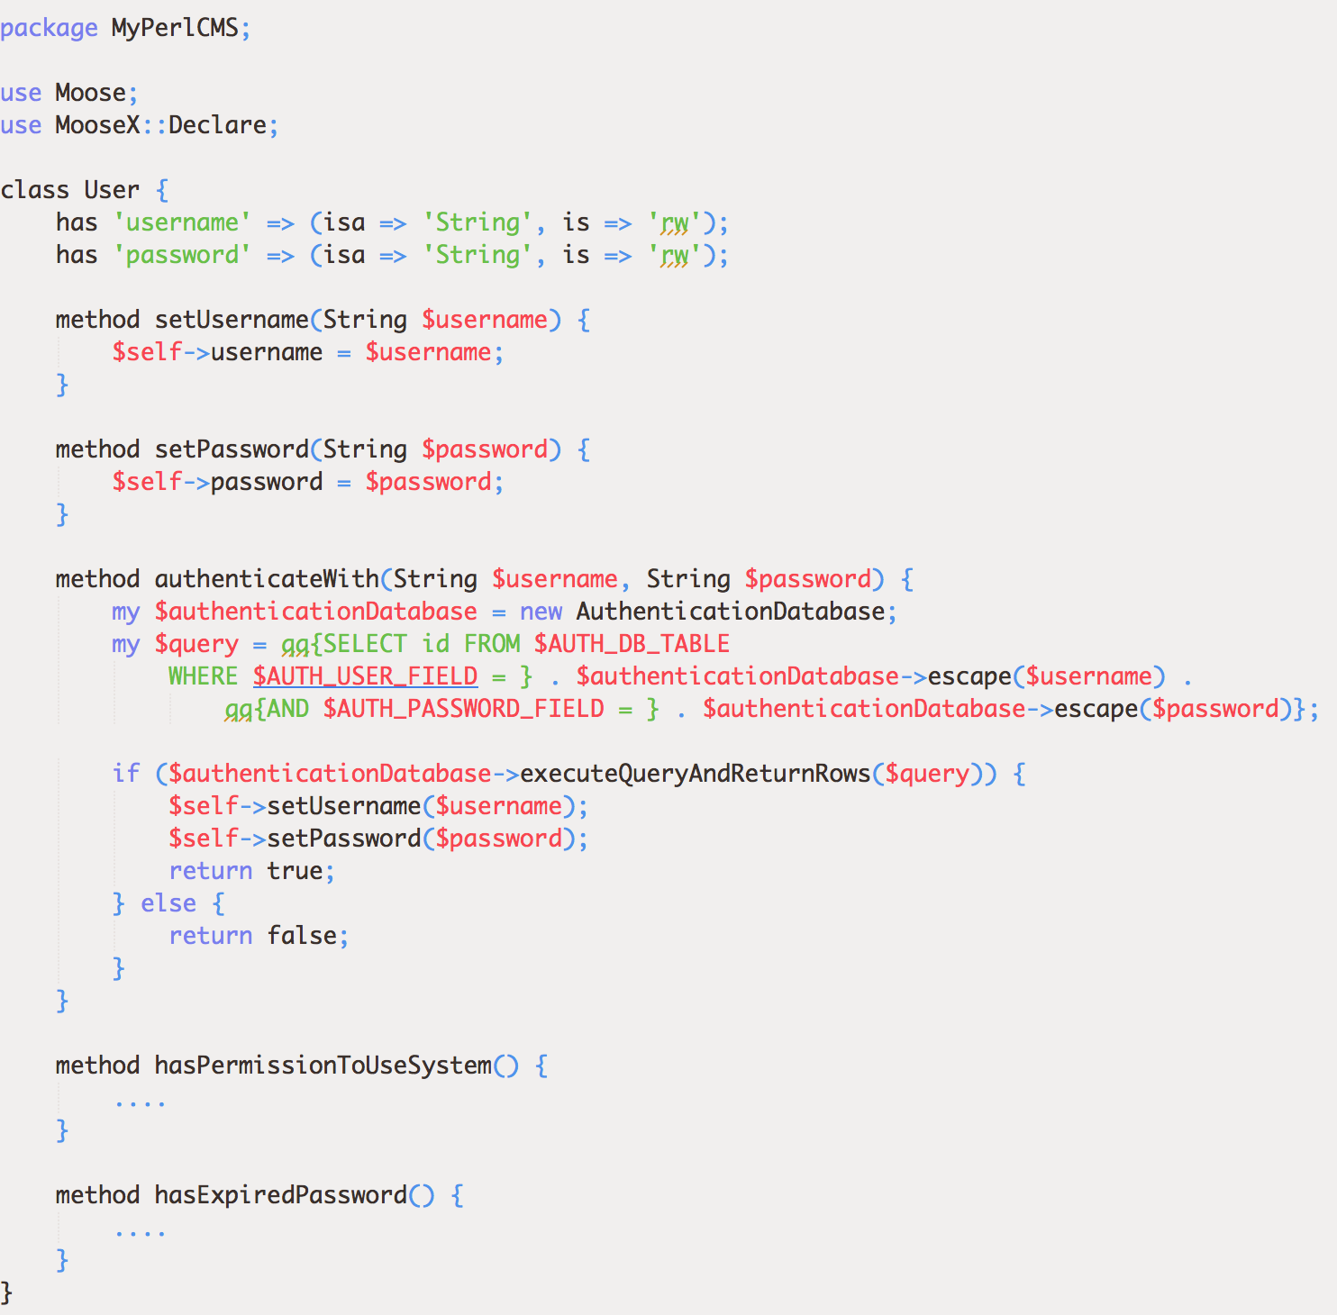
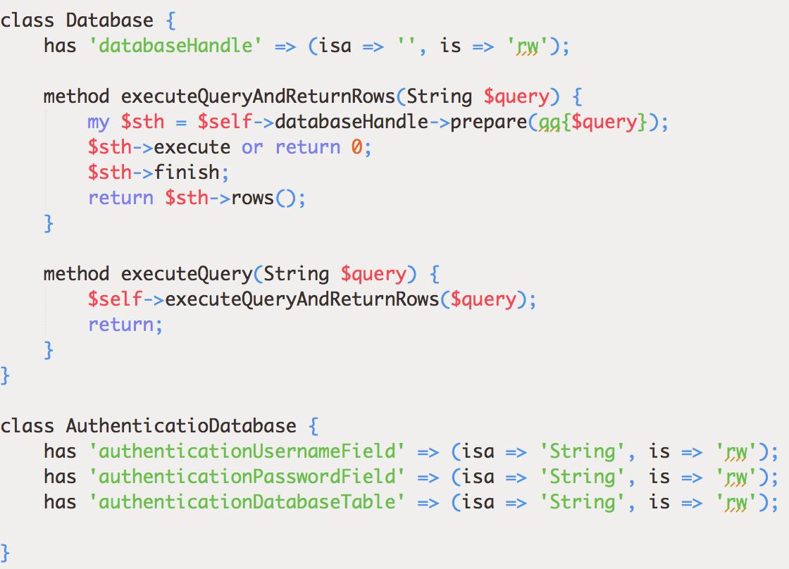
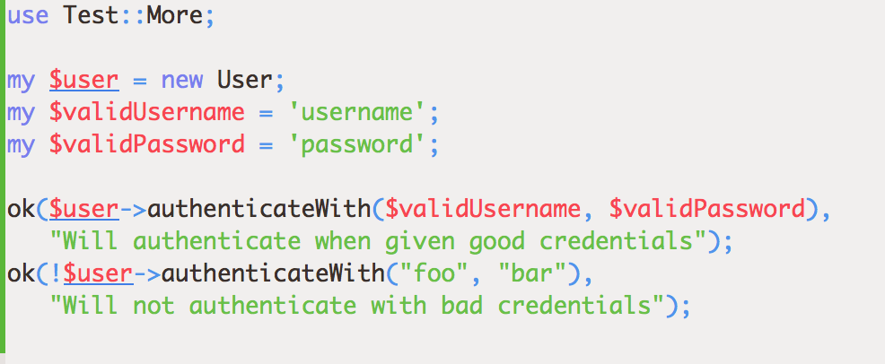
We could extract domain functionality into classes with tests

Slide 33
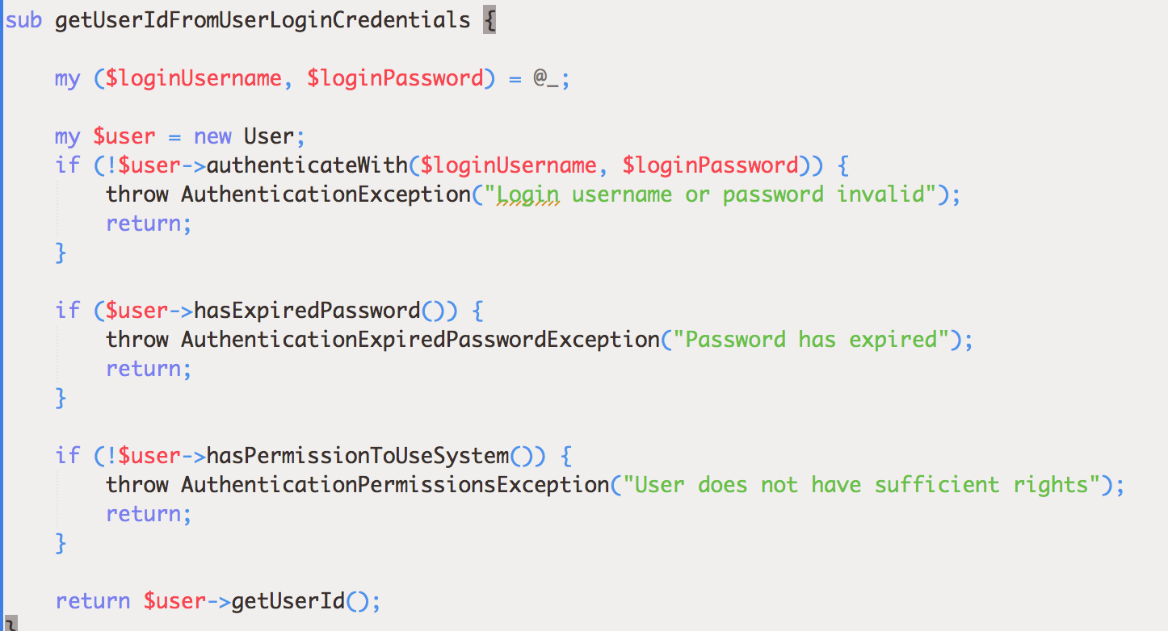
We can end up with more readable code
sub check_login { my ($query, $pathinfo, $dbh) = @_; my $login_email = $query->param($AUTH_USER_FIELD); my $login_pass = $query->param($AUTH_PASSWORD_FIELD); my ($statement, $sth, $id, $login, $admin_level, $cookie); $statement = qq{SELECT id FROM $AUTH_DB_TABLE WHERE $AUTH_USER_FIELD = '$login_email' AND $AUTH_PASSWORD_FIELD = '$login_pass'}; $sth = $dbh->prepare($statement); $sth->execute or die("Unable to execute $statement", $dbh->errstr); $sth->finish; # get the count of rows in the database # $x is the row count going forwards if ($sth->rows eq 0) { ChangingPages->fetch_page(APP_OPTIONS => \%APP_OPTIONS, QUERY => $query, FILE_NAME => $pathinfo . $query->param('_error_page'), ); return; } $statement = qq{ SELECT id, $AUTH_USER_FIELD, admin_level FROM $AUTH_DB_TABLE WHERE $AUTH_USER_FIELD = '$login_email' AND $AUTH_PASSWORD_FIELD = '$login_pass' AND (TO_DAYS(NOW()) - TO_DAYS(last_mod_pwd)) < $MAX_PASSWORD_EXPIRY }; $sth = $dbh->prepare($statement); $sth->execute or die("Unable to execute $statement", $dbh->errstr); if ($sth->rows eq 0) { $sth->finish; &display_change_passwd; return; } $sth->bind_columns(undef, \$id, \$login, \$admin_level); $sth->fetch; $sth->finish;

Slide 34
Take on Technical Debt knowingly
It’s about knowing what the risks are
Keep a Tech Debt Wall
Note down any technical debt you accrue as you develop
Consider the risk of postponing resolution vs the cost of sorting now
Don’t engineer the future: resolve in the next iteration
Regularly review the Tech Debt Wall
Categorise the debt on the wall
Take highest risk technical debt into backlog and resolve

Slide 35
Tech Debt Wall example

Slide 36
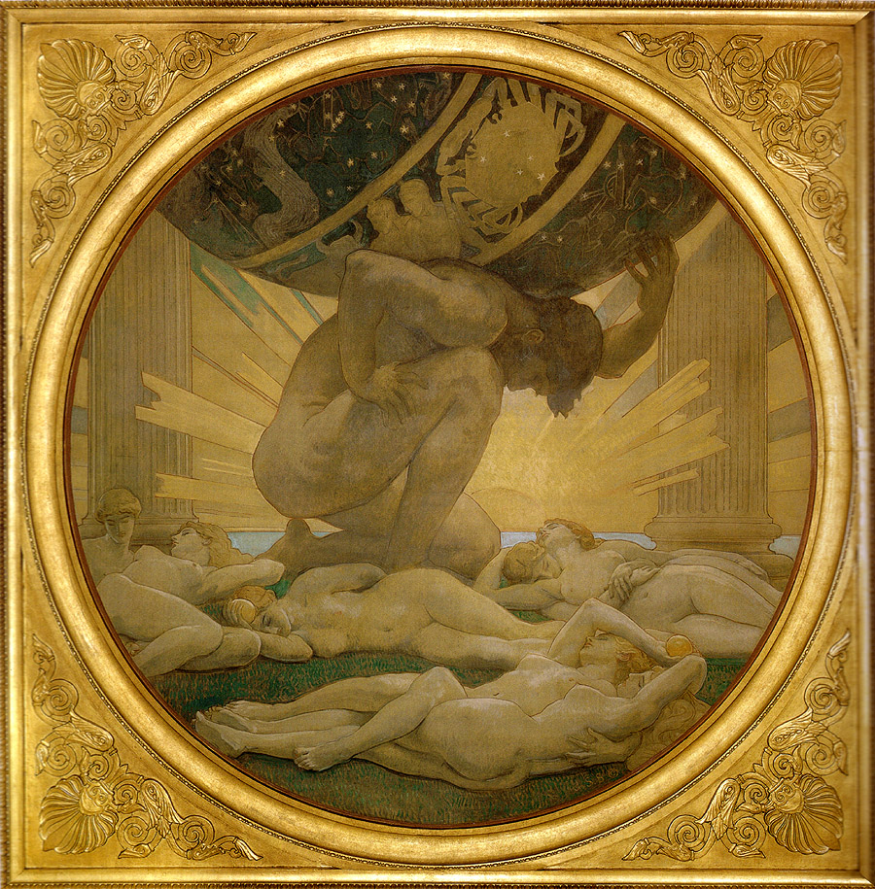
What the business can do to help
Understand that it will take time to sort out.
Ensure the product pipeline accounts for it.
Support training and coaching for the team.
Create a safe environment.
Alleviate pressures.
Appreciate that
some people will be more resistant to change.
people learn in different ways
people learn at different speeds.
some people will not (want to) change.

Slide 37
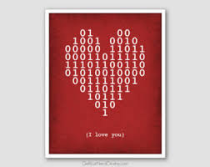
How I learned to love legacy code
I realised it’s an asset.
I realised it needs caring for, and improving.
I realised we shouldn’t blame ourselves or others.
I realised we had to own the code.
I realised we could have pride about it.
I realised we could and had to make it better.
I realised the Big Rewrite is tempting, but risky.
I realised the right tools & practices really help.

Slide 38
Here’s a list of a few books
Working Effectively With Legacy Code – Michael Feathers (2004)
Clean Code – Robert C Martin (2008)
The Clean Coder – Robert C Martin (2011)
Beyond Legacy Code – David Scott Bernstein (2015)
Lean Software Development – Mary & Tom Poppendieck (2003)
Refactoring: Improving the Design of Existing Code – Martin Fowler, Kent Beck, et al (1999, 2018)
Refactoring Databases: Evolutionary Database Design – Scott J Ambler & Pramod J Sadalage (2006)
Head First Design Patterns - Eric Freeman, et al (2014)
Domain-Driven Design: Tackling Complexity in the Heart of Software – Eric Evans (2003)

Slide 39
STOP RUN.
Thank You
07811 671 893
m.harris@elsevier.com
https://www.ssrn.com
http://uk.linkedin.com/in/mbharris
https://github.com/mikebharris/
© 2017-2018 Mike Harris under GNU FDL 1.3

